Slide 1
Front End Engineering-II Project
Project Name: JOBSTER
Team Details:
Jashanjit Kaur (2210990440)
Jinny Kapur (2210990462)
Jiya Gaba (2210990464)
Kashika (2210990493)
Faculty Coordinator: Vikas Patel
Chitkara University Institute of Engineering and Technology,
Chitkara University, Punjab

Slide 2
Table of Contents
Introduction
Problem Statement
Technical Details
Key Features
Project Highlights
Conclusion
References/Links used

Slide 3
Introduction
In this project, we have created a job management application with a user-friendly interface. It include features like landing page, error handling for unauthenticated users, registration, login, dashboard with stats and job listings. .With Jobster, users can effortlessly track job listings from various sources, manage application details including deadlines and follow-ups

Slide 4
Problem Statement
The main problem this project solves is creating a responsive website which simplify job management for users. It allow users to login, register and manage their job application efficiently. Additionally, provides a demo user option for testing without registration.

Slide 5

Technical Details
In this project ,we are building a front-end application using Redux Toolkit and Axios tot rack job application progress, manage job listings, and interact with a server for data management and user authentication.

Slide 6
Key Features
In this users can create, edit, delete and view all their job application.
Implementation of HTTP requests to communicate with a server ,allowing for data retrieval , creation
Secure login and registration process, ensuring that only authenticated users can access application features.
Initialization of protected routes to restrict access to certain parts of application based on user authentication status.
Display of statistics such as pending applications, scheduled interviews.

Slide 7
Project Highlights
Utilizing Redux Toolkit for efficient state management.
Implementing complex HTTP requests to interact with a server, including handling data requests.
Secure login and registration processes to ensure that only authorized users can access application.
Setting up protected routes to restrict access to certain parts of application based on user authentication status.
Learning modern application setup where the server is data provider and front end is responsible for displaying data.

Slide 8
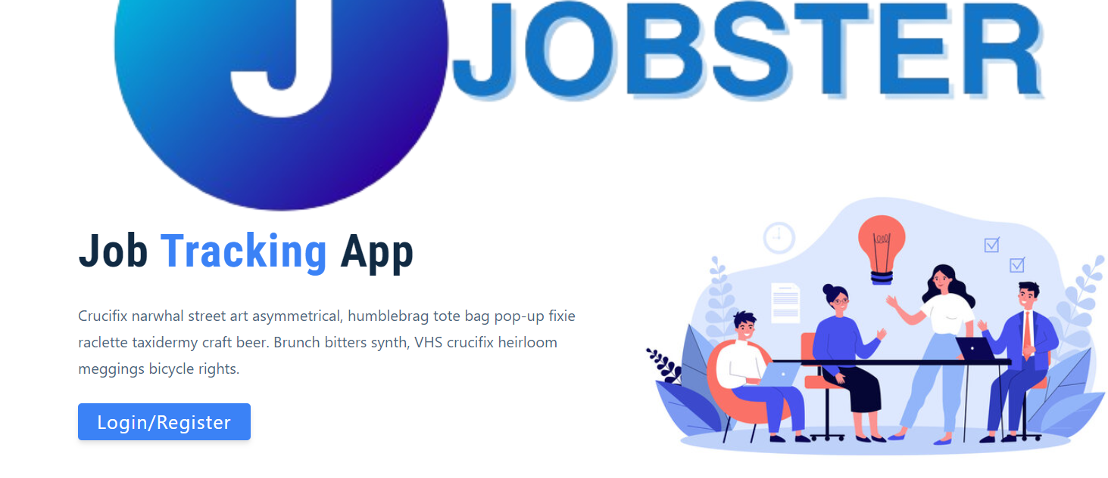
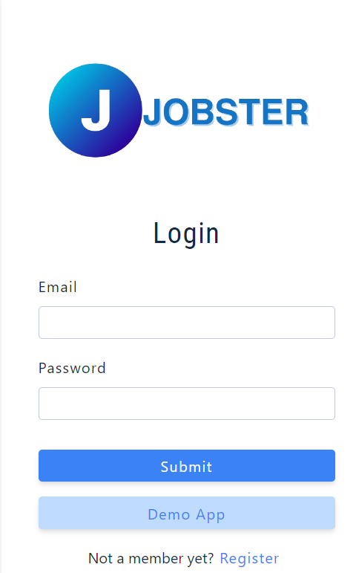
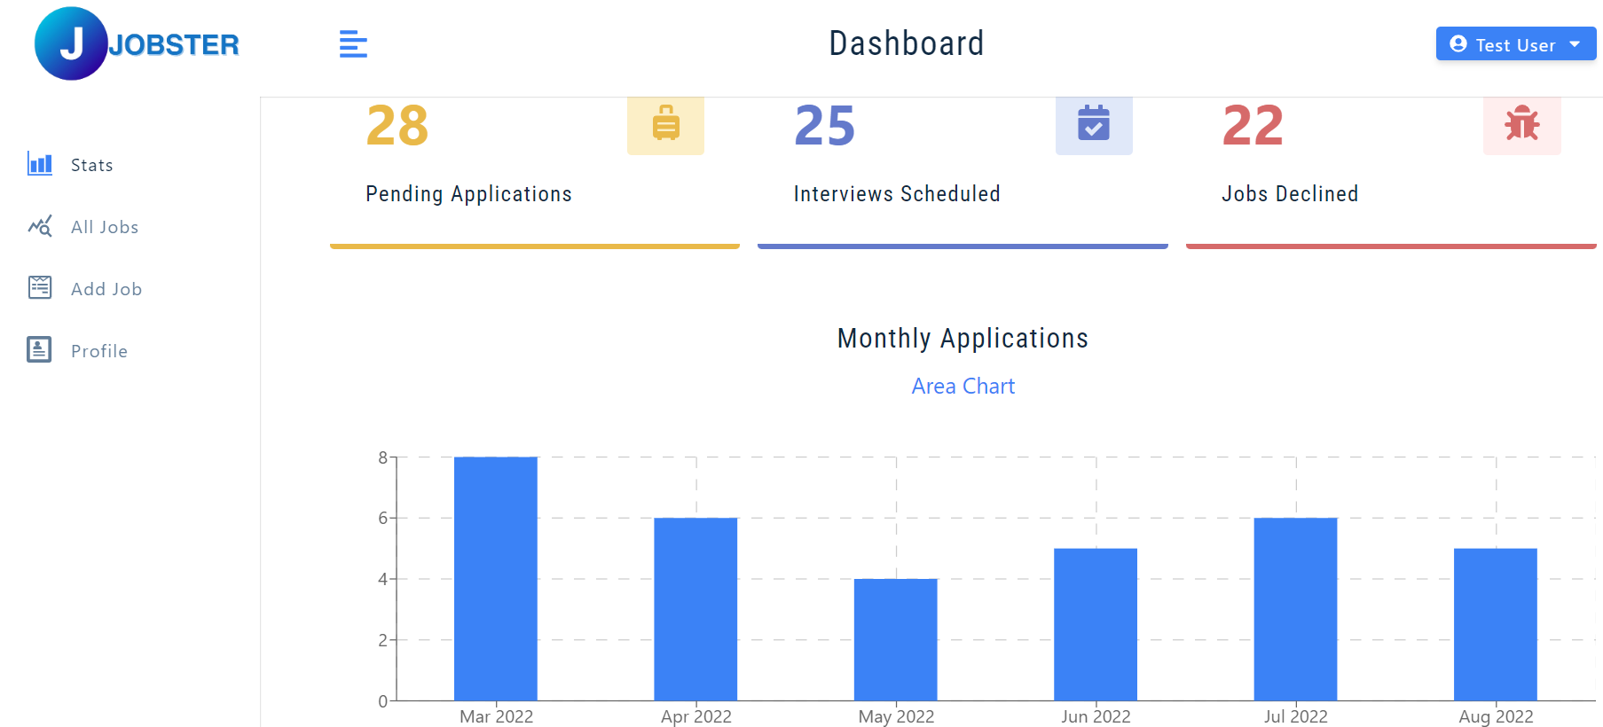
Highlights Of The Project

Slide 9
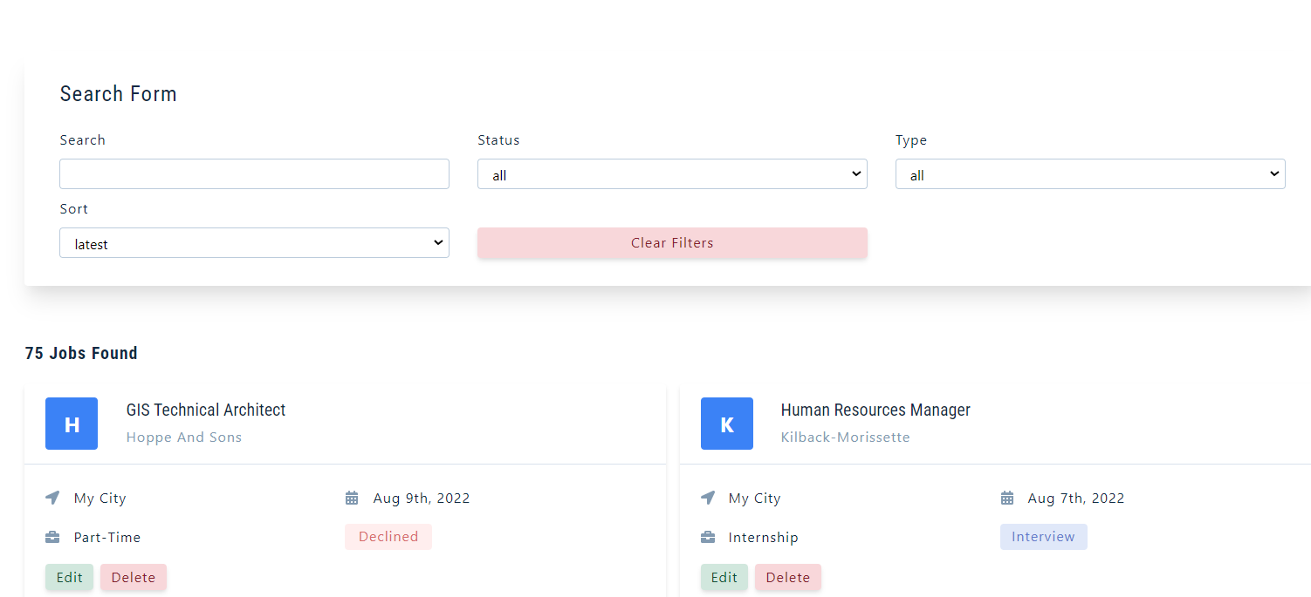
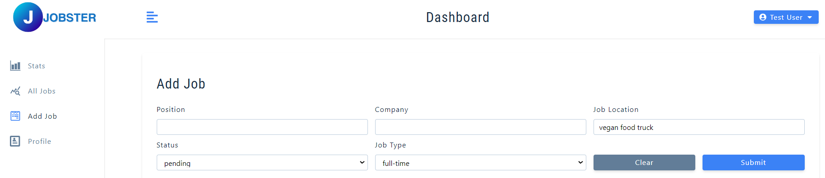

Slide 10
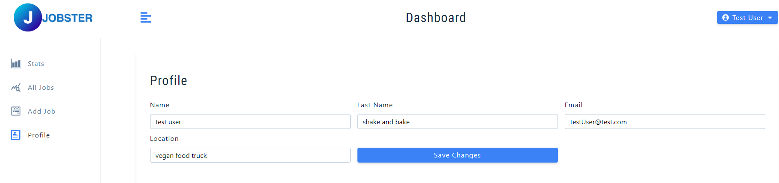
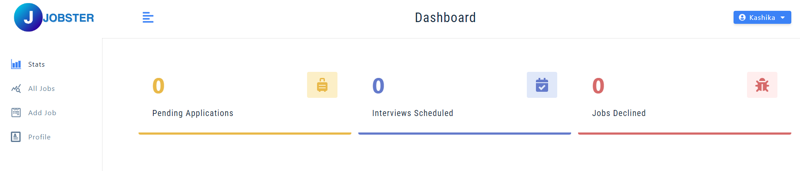
Highlights

Slide 11
Conclusion
In conclusion, Jobster project is comprehensive front-end application that demonstrates the implementation of complex features such as user authentication, server communication, and state management using Redux Toolkit.

Slide 12
References/Links used
Udemy
https://legacy.reactjs.org
3. https://www.npmjs.com/

Slide 13


